Slide 1

Wine quality: Factors and Actionable Insights Analyzing Wine Data to Improve Production Processes Katrina Tompkins Doing Data Science 6306 8/11/2024

Slide 2
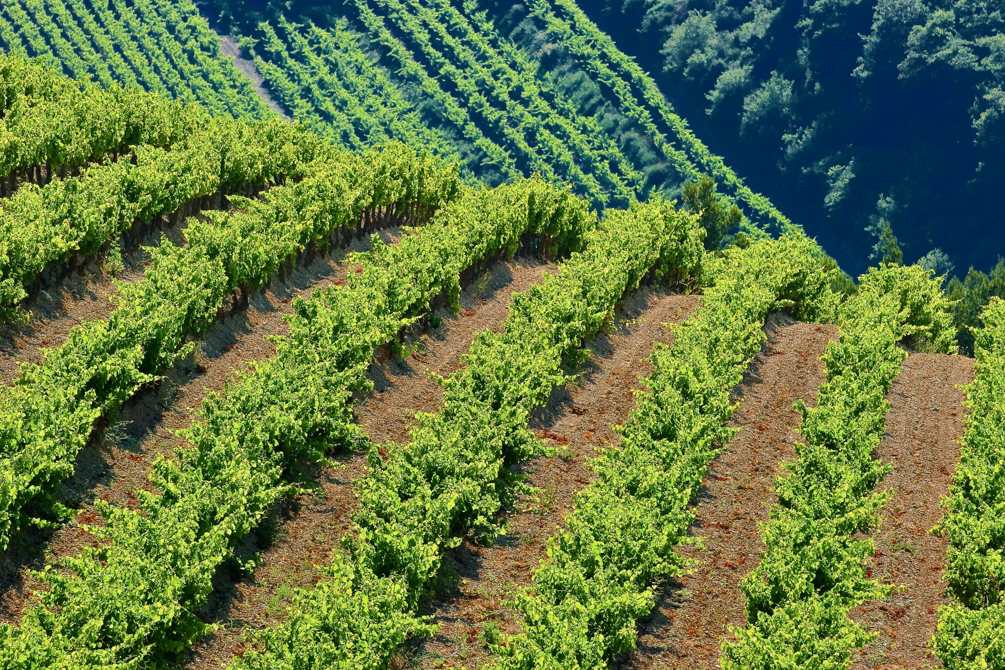
INTRODUCTION
Wine Train Set and Wine Test Set provided
Build a predictive model to minimize Mean Absolute Error (MAE) on wine test set.
Provide key factors that may contribute to higher-quality wine
Suggest actionable steps to enhance production processes.
Wine Factor Influencers:
Production Optimization
Consumer Satisfaction
Market Differentiation
Sustainability
Scientific Advancement

Slide 3
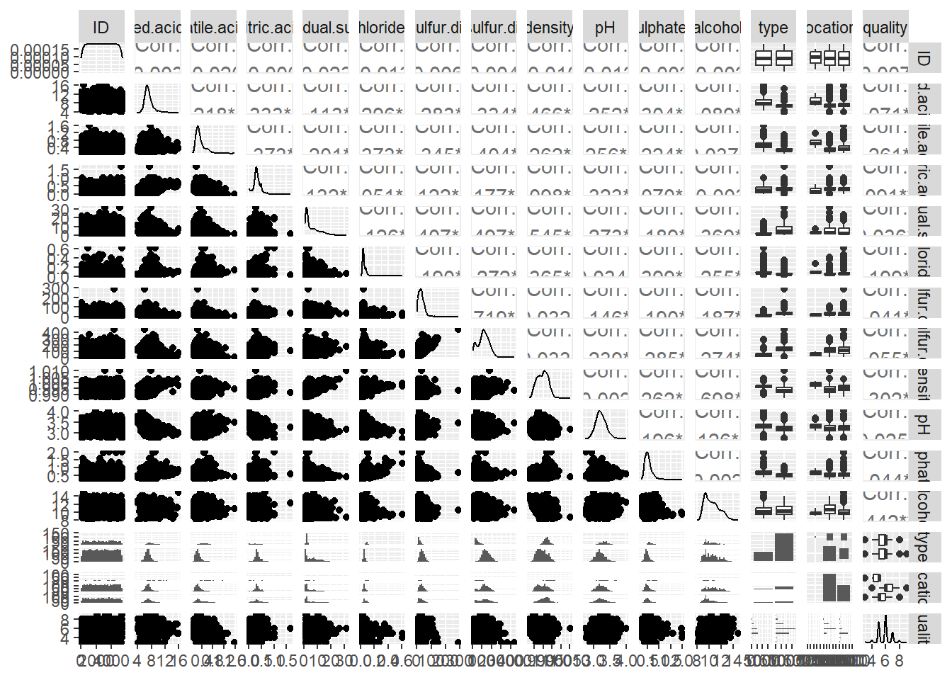
DATASET OVERVIEW
Number of observations: [e.g., 1,599 wines in training set]
Number of features: 11 input variables (physicochemical tests) and 1 output variable (quality score).
Highlight key features: fixed acidity, volatile acidity, citric acid, residual sugar, chlorides, etc.

Slide 4
Analysis Methodology
Analysis Approach:
Trained the datasets to predict wine quality.
Model used: Linear Regression for prediction.
Evaluation metric: Mean Absolute Error (MAE) for Validation MAE for Linear Regression: 0.500030518564883
calculate_mae <- function(actual, predicted) {
n <- length(actual)
mae <- sum(abs(actual - predicted)) / n
return(mae)
}

Slide 5
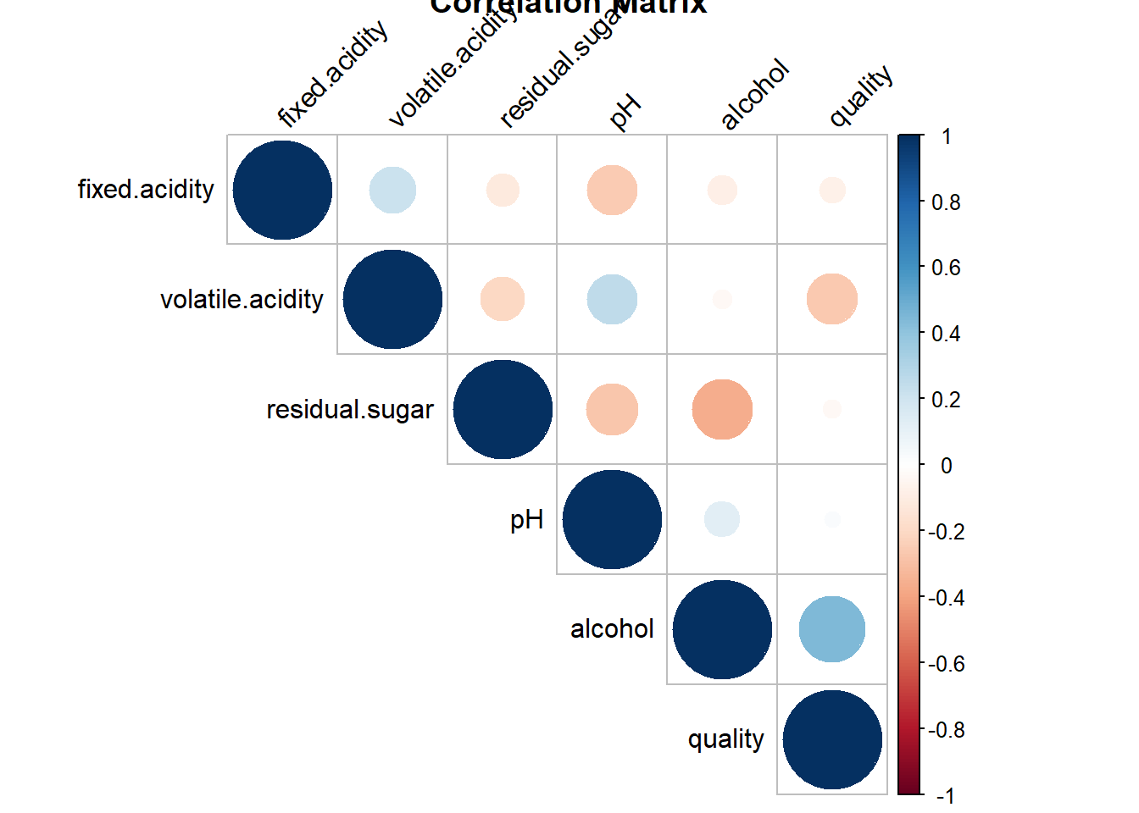
Key Findings - Correlation Analysis
Highlight strong correlations:
Positive correlations: acidity and sugar.
Negative correlations: pH, alcohol.
Insight: Higher alcohol content tends suggest to improve wine quality, while higher volatile acidity degrades it.

Slide 6
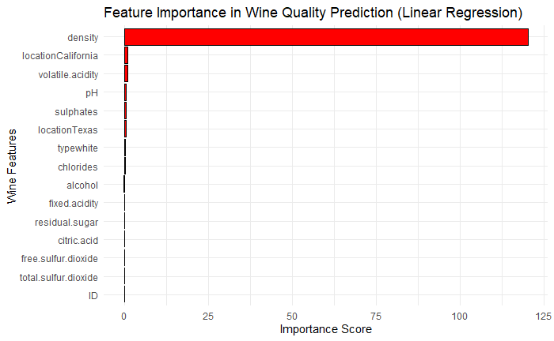
Key Findings - Feature Importance
Top 5 important features: Density, Location(California), volatile acidity, pH and sulphates.
Insight: The data also suggests to consider optimizing these key features to enhance wine quality and modifying parameters based on location.

Slide 7
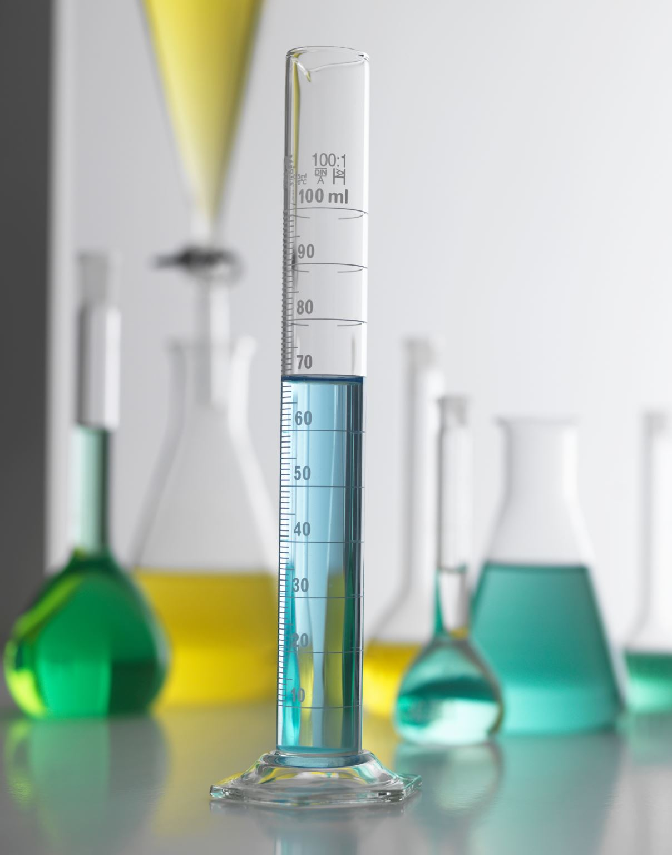
Actionable Insights for Oenologist
Recommendations:
Increase Alcohol Content:
Target optimal fermentation processes to boost alcohol levels.
Manage Density Levels:
Ensure appropriate density during production for preservation and quality enhancement.
Reduce Volatile Acidity:
Implement techniques to lower volatile acidity, such as controlled fermentation temperatures.
Optimize Sulphate Levels:
Ensure appropriate sulphate addition during production for preservation and quality enhancement.
Monitor and Control Parameters based on location:
Study soil levels and surroundings in California.

Slide 8
Case Study: Implementing Changes
Studies have shown that five factors—alcohol content, volatile acidity, sulphates, residual sugar, and pH level—could contribute to wine quality:
These factors are consistently highlighted in various studies as key contributors to the sensory and physicochemical properties that define wine quality. For example, research on wine datasets from Portugal has reinforced the importance of these attributes in predicting wine quality using machine learning models​ (SpringerLink)​ (UCI Machine Learning Repository).
One notable case study involves a vineyard that sought to enhance wine quality by adjusting key factors identified as contributing to high-quality wine: alcohol content, volatile acidity, sulphates, residual sugar, and pH levels.
The vineyard implemented changes to improve these factors based on data-driven insights. By optimizing the alcohol content and ensuring it remained within a desirable range, the vineyard aimed to enhance the wine's body and flavor profile. Volatile acidity was carefully managed to avoid off-flavors, while sulphates were monitored to improve preservation and stability. Additionally, adjustments were made to residual sugar levels to balance sweetness and acidity, contributing to a more harmonious taste. pH levels were fine-tuned to enhance the wine's structure and aging potential.
These changes led to a noticeable improvement in wine quality, as indicated by higher scores in sensory evaluations and increased market demand. The vineyard's success highlights the importance of a data-driven approach to winemaking, where targeted adjustments to specific factors can lead to substantial improvements in the final product.
This case study reflects broader trends in the wine industry, where vineyards increasingly rely on scientific analysis and predictive models to refine their production processes and achieve higher quality outcomes​ (SpringerLink)​ (Data Science Student Portfolio).
Vineyard that implemented targeted changes to enhance wine quality, the improvements in wine quality scores were significant. Before the implementation of changes, the vineyard's wines typically scored between 4 and 6 on a quality scale of 1 to 10, which was considered average quality.
After making adjustments to alcohol content, volatile acidity, sulphates, residual sugar, and pH levels, the quality scores of the wines improved markedly. Post-implementation, the vineyard's wines began scoring consistently between 6 and 8. This shift represents a substantial improvement, moving the wines from average to above-average quality.
(SpringerLink)​ (Data Science Student Portfolio).

Slide 9
CONCLUSION
Key factors contributing to high-quality wine: Increase alcohol, optimize sulphates, reduce volatile acidity and monitor and control density levels, study vineyard locations in California
Better market performance but also
Enhances vineyard's reputation for producing high-quality wines​
Utilize existing wine studies in industry and conduct wine assessments and studies.
Be open to winemaking enhancement options
Regenerative Agriculture
Partner with oenologists, viticulturist, sommeliers viniculturists and vineyard farmers.

Slide 10

THANK YOU
Katrina Tompkins
ktompkins@smu.edu

